Slide 1
CIS 4004: Web-Based Information Technology
Summer 2014
Homework Assignment #6 (100 pts)
Due Wednesday July 30, 2014
Instructor : Dr. Mark Llewellyn
markl@cs.ucf.edu
HEC 236, 407-823-2790
http://www.cs.ucf.edu/courses/cis4004/sum2014
Department of Electrical Engineering and Computer Science
University of Central Florida
Notes:
Phd, MS, Under

Slide 2
Homework Assignment #6
This assignment has two main objectives:
(1) To allow you to apply many of the HTML5, CSS3, and JavaScript (including jQuery and jQuery UI) capabilities that you’ve learned this semester into a single web page.
(2) To utilize the CSS3 advanced page layout properties to allow you to produce a multi-row, multi-column professional looking layout.
Assignment due date: Wednesday July 30, 2014 by 11:59pm WebCourses time. No extensions are possible for this assignment.

Slide 3
HTML For Assignment #6
This project has no specified content in that you are free to theme your webpage(s) to whatever topic you would like.
There are several requirements that your webpage must include. Be sure to read this document carefully and incorporate all of these requirements into your document.
The manner in which you include/represent them is somewhat open based upon the various requirements (see subsequent pages for detailed explanations of the various requirements).
Your page layout must be multi-row and multi-column format. The number of rows and columns must each be greater than one, but the exact number is your choice. I’ve developed one for this assignment. which is basically three rows and two columns, that I use to illustrate several of the requirements for this assignment that is shown on subsequent pages.

Slide 4
HTML For Assignment #6
You should include a comment file with your submission that explains how you’ve chosen to implement the requirements for this project.
For example, if you use jQuery UI to provide a styling theme for your page, indicate this is want you’ve done and indicate which pre-defined theme you used or describe the way you used the ThemeRoller to create your custom theme.
Indicate in this comment file all of the dynamic features of your page that were developed both by you using JavaScript as well as those that you incorporated using jQuery and/or jQuery UI.

Slide 5
Requirements For Assignment #6
Your HTML5 must successfully validate and contain no inline styles. (See deliverables.)
Your CSS must all be external to the markup and successfully validate. No inline or embedded (internal) styles will be allowed. (See deliverables.) Multiple external style sheets are fine.
Your JavaScript must be external to the markup. (See deliverables.)
Your page layout must be multi-row and multi-column format. The number of rows and columns must each be greater than one, but the exact number is your choice.
At least one element in your markup should be styled to illustrate a radiused corner on a box.
Your page should include at least 2 different images (excluding any background image that you might choose to use).
At least one navigation link must include a pop-up sub-menu that appears when the user clicks the navigation link. See page 8.

Slide 6
Requirements For Assignment #6
Your page must include one form. The form can be fairly simple, as illustrated in the example. The form does not need to be handled (i.e., no action attribute need be specified). Your form must use the proper form elements as we covered in class.
All navigation links must work. Navigation links should be a mixture of internal and external links.
At least one element on your page should use a shadow on the box. In the example webpage, I placed the shadow on the bottom borders of the images at the bottom of the page.
You must use semantically correct HTML5 markup elements such as article, section, aside, header, footer, etc.

Slide 7
Requirements For Assignment #6
At least one of your images should have a pop-up that is controlled by the user moving the mouse over or moving the mouse out of the image. The effect you want is illustrated on pages 9 and 10. (Recall your JavaScript efforts from Assignments #4 and #5.)
Your page should include at least one list. I styled the list element bullets in my example, but you do not need to do this unless you want to do so.
Colors are entirely your choice, but be sure to have overall good contrast.
You can assume that we’ll test your page on a W3C-compliant browser.
You can use jQuery and/or jQuery UI to achieve a dynamic effect on your page, but you must also include some JavaScript that you created.

Slide 8
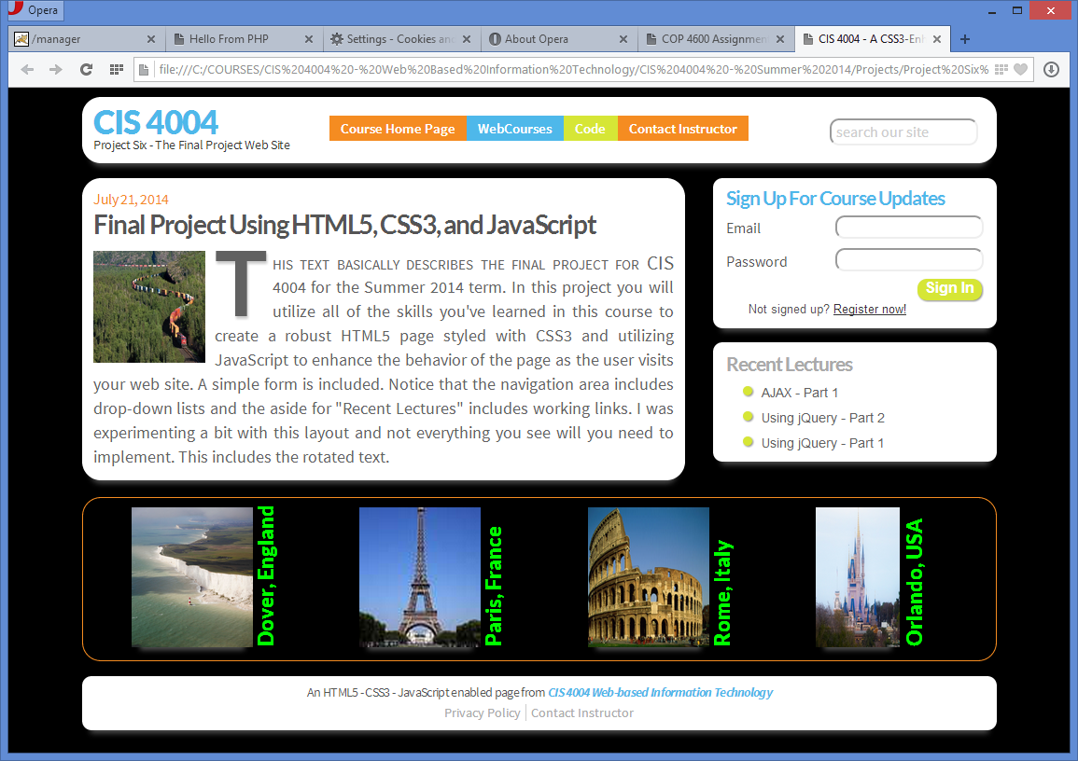

Slide 9
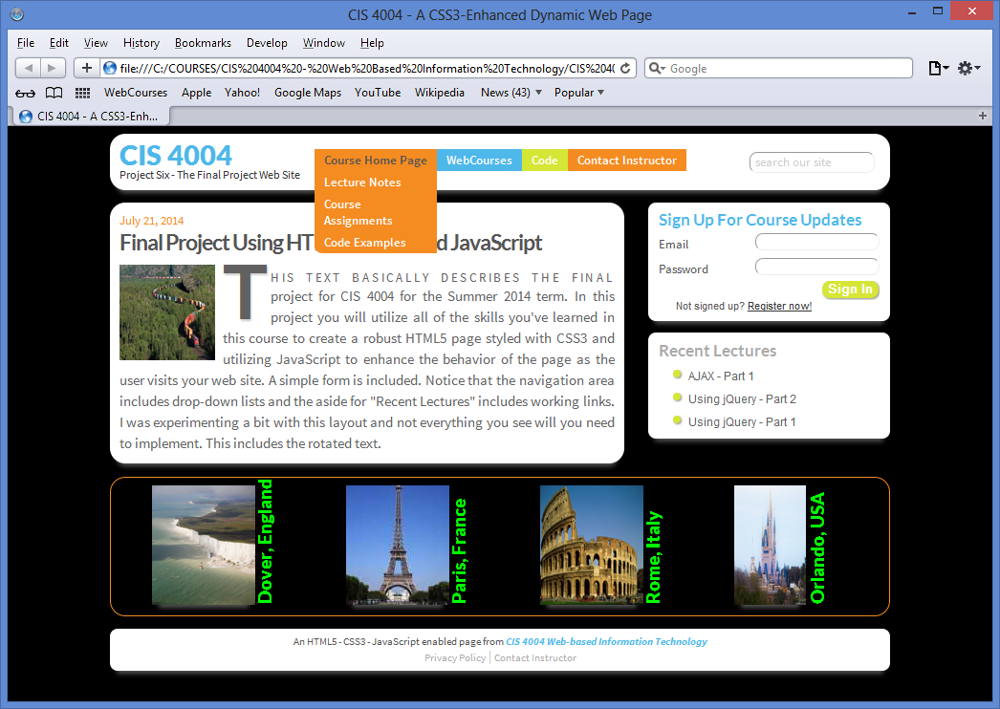
Drop-down list in navigation area appears when user moves the mouse over the element.

Slide 10
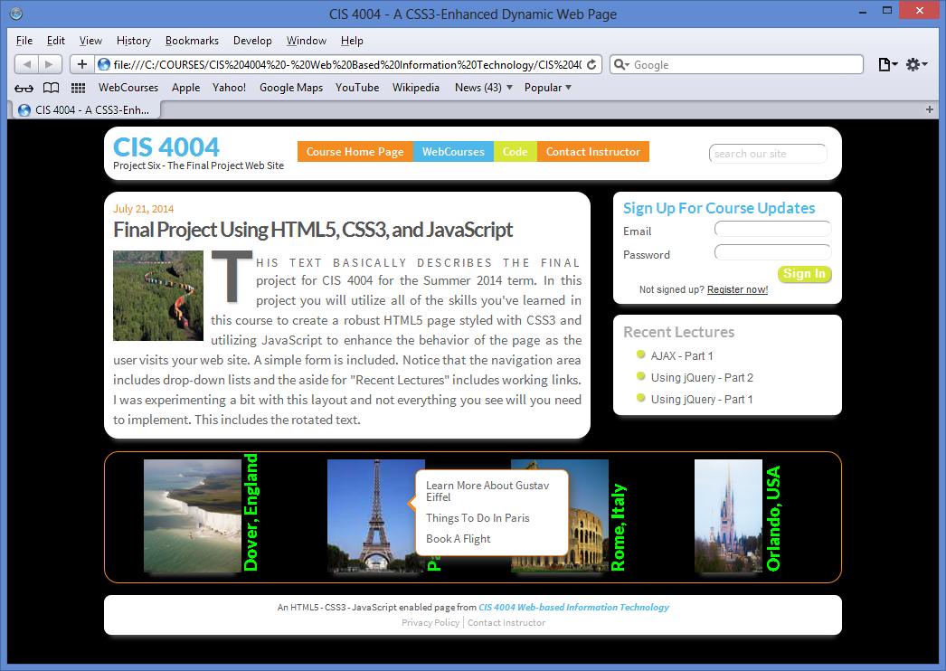
Pop-up appears when user moves cursor over image and disappears when user moves off of image. Notice how the two images on the left side of the page have their pop-ups appear on the right side of the images. . .

Slide 11
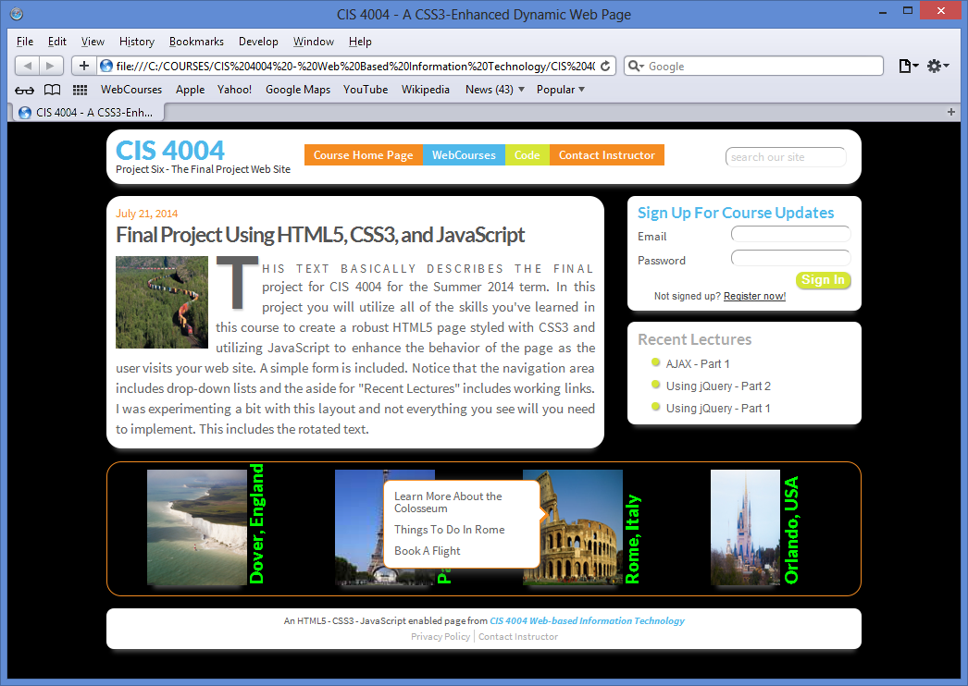
And for the two images that appear on the right side of the page, their pop-ups appear on the left side of the image.

Slide 12
When And What To Turn In
The deliverables for this assignment are:
    A semantically correct HTML5 markup document (25 pts).
    The CSS external stylesheet(s) (20 pts).
    The JavaScript file (20 pts).
    Correct use of jQuery and/or jQuery UI libraries. (10 points).
    A document containing screen captures for both HTML5 validation that shows only the one warning as shown on the next page and CSS validation (all passing!). Make sure that the name of the validated file appears in the screen shot. (10 pts).
    Screen shots of your final rendered document illustrating the various features, similar to those in this document. (10 pts).
    A comments file as described in this document (5 pts).
  The deliverables for this assignment are to be submitted via WebCourses no later than 11:59pm (WebCourses time) on Wednesday July 30, 2014. There cannot be any extensions on this project due to grading time constraints.

